Slide 1
2/28/18
Getting Started with Altium Designer
Go to https://remote.engr.wisc.edu and open Altium while we get started!

Slide 2
Overview
PCB Basics
Schematic editing
Schematic Components
Component Layout
Basic Routing

Slide 3
Limitations
Topics for a future seminar:
Hotkeys
Shortcuts
Altium 18
Changing Design Rules
3D Design
Try to keep up:
We’ll go at the average pace of the group
Helpers will come around and troubleshoot
If you get too far behind, look at someone else’s screen and we can help at the end

Slide 4
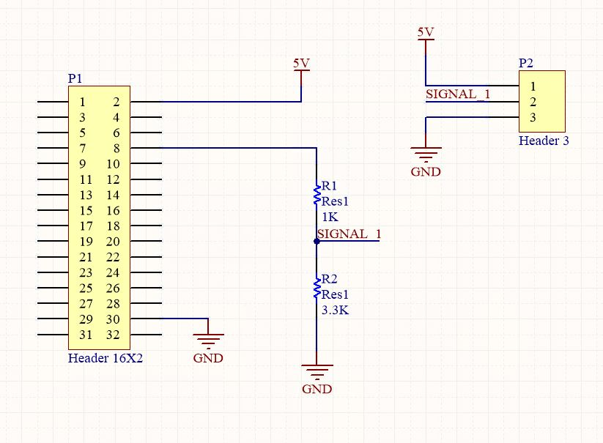
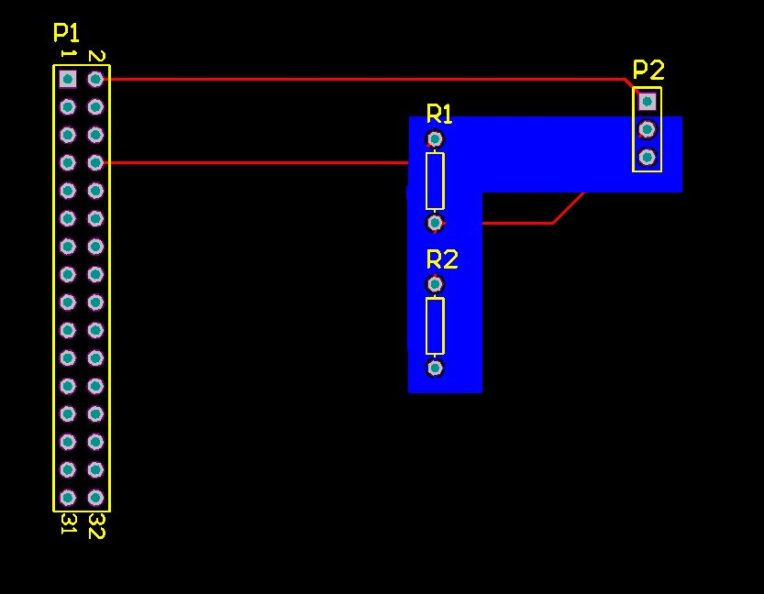
What will we make?

Slide 5
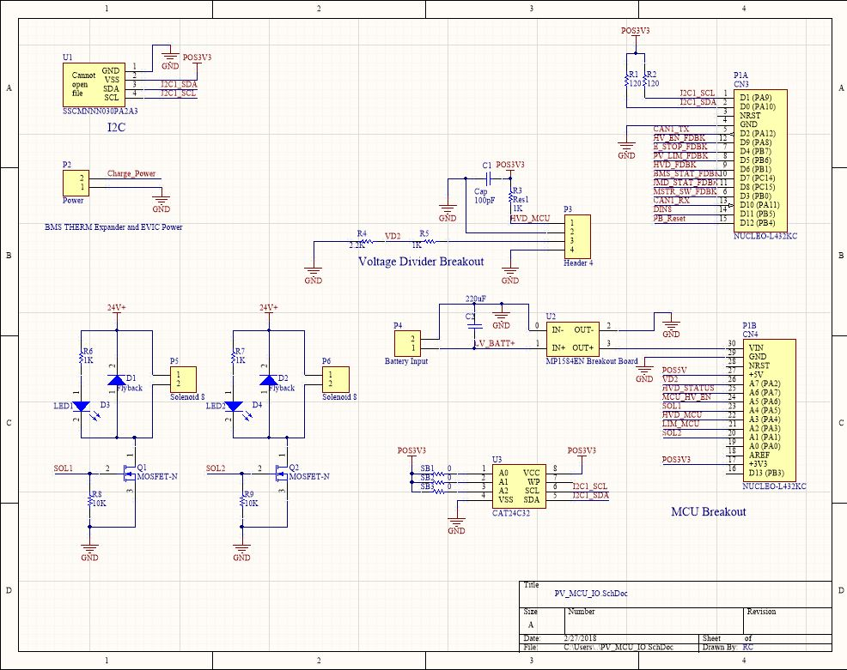
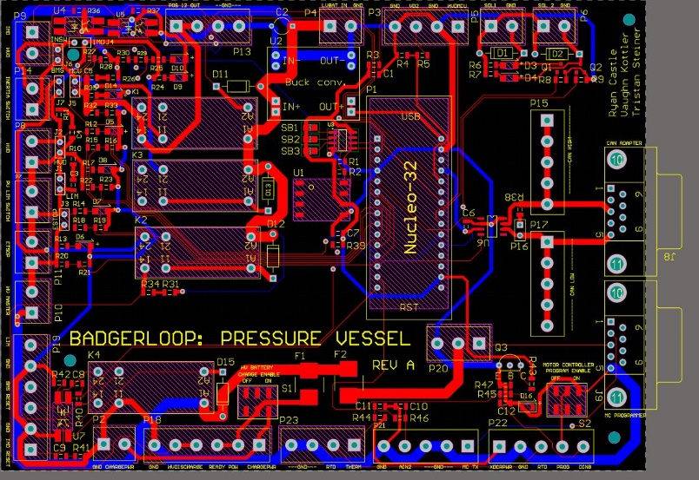
What more can you make with Altium?
Some of Badgerloop’s Schematics and boards

Slide 6
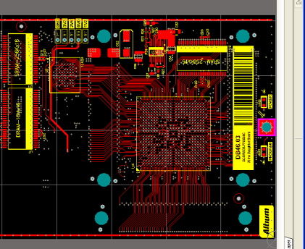
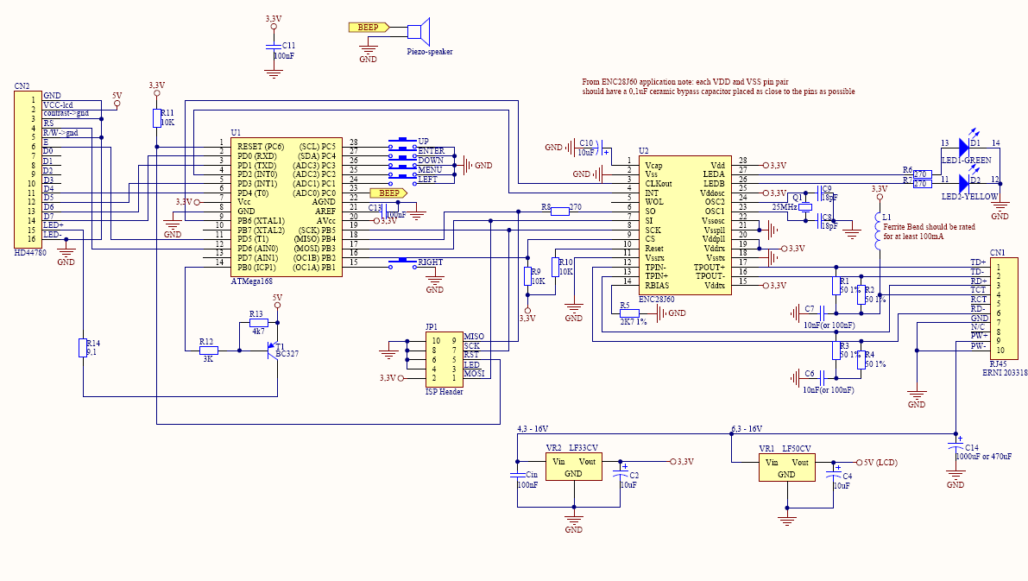
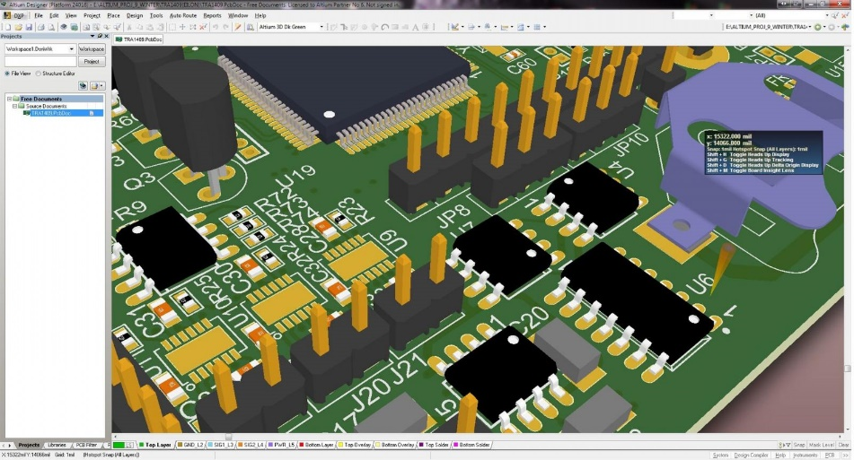
What more can you make with Altium?
Professional PCBs, dozens of layers, 3D, etc.

Slide 7
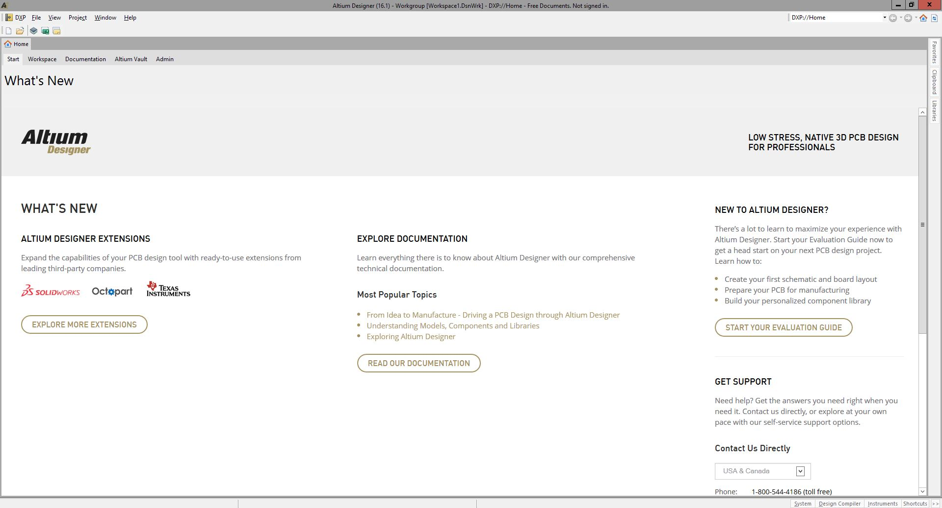
Getting Started

Slide 8
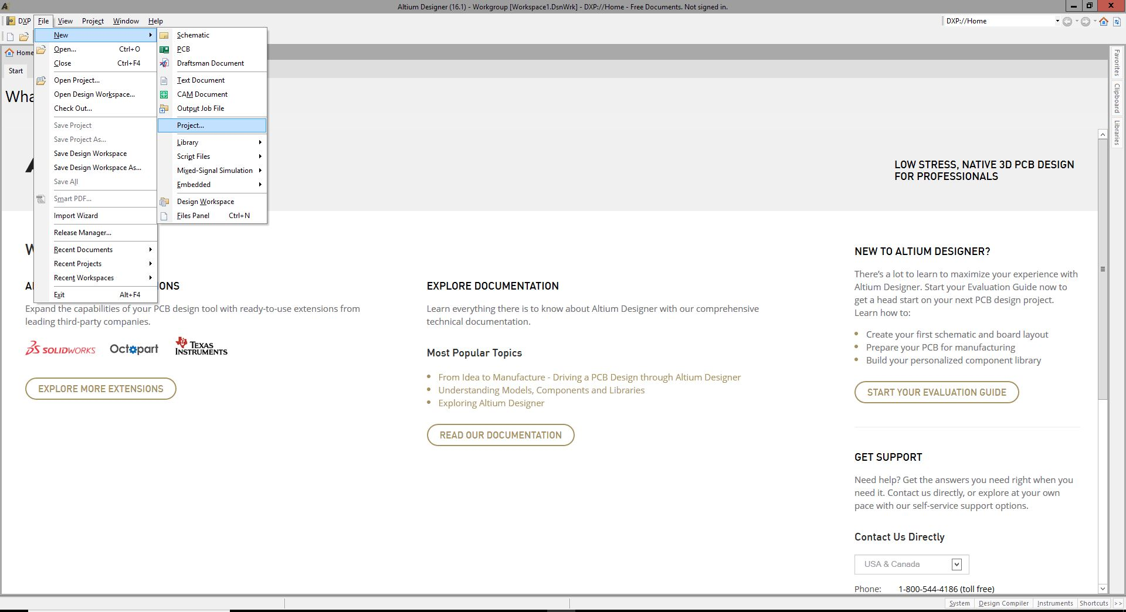
Open a new project

Slide 9
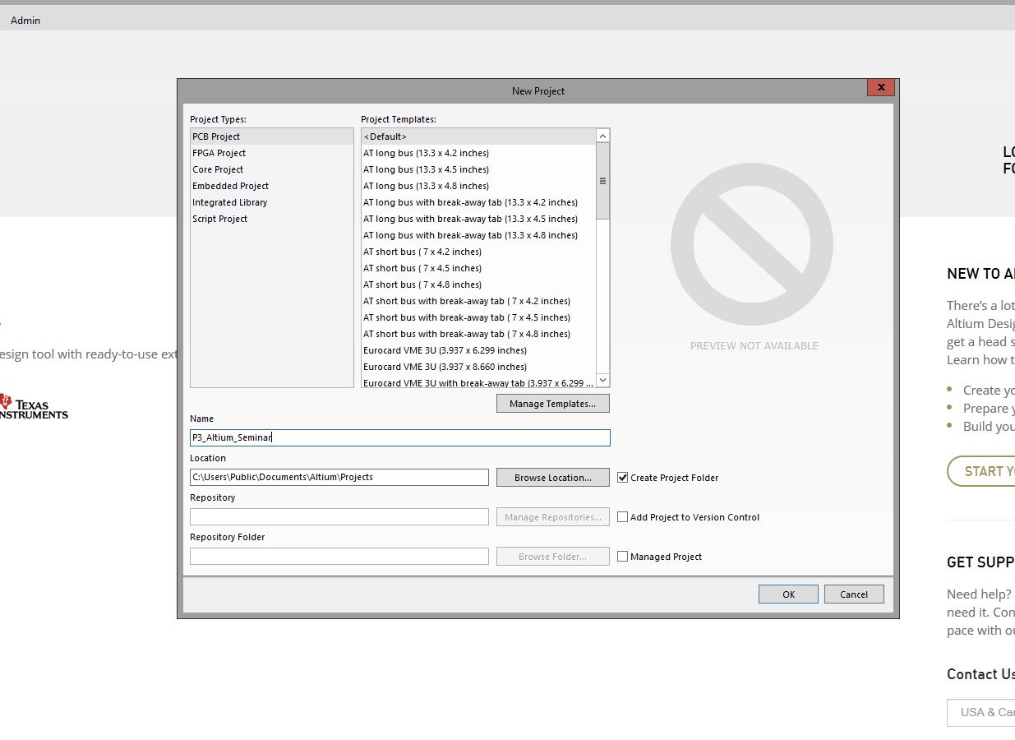
Open a new project

Slide 10
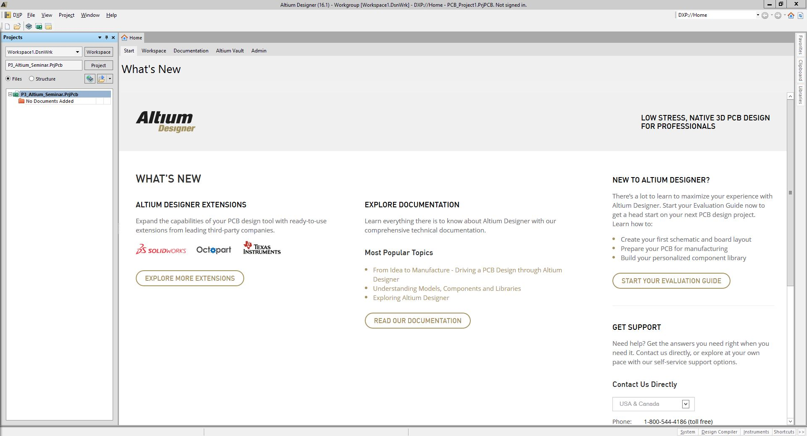
New Project Window

Slide 11
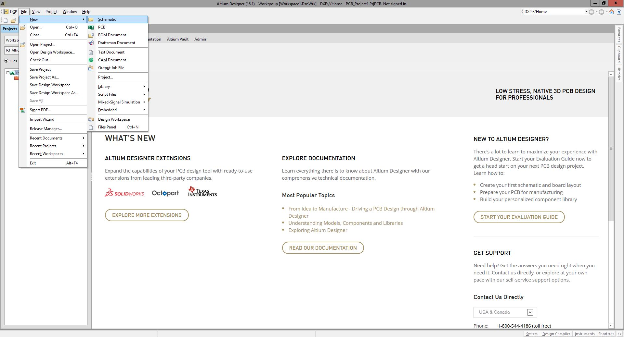
Creating Schematic and PCB Files

Slide 12
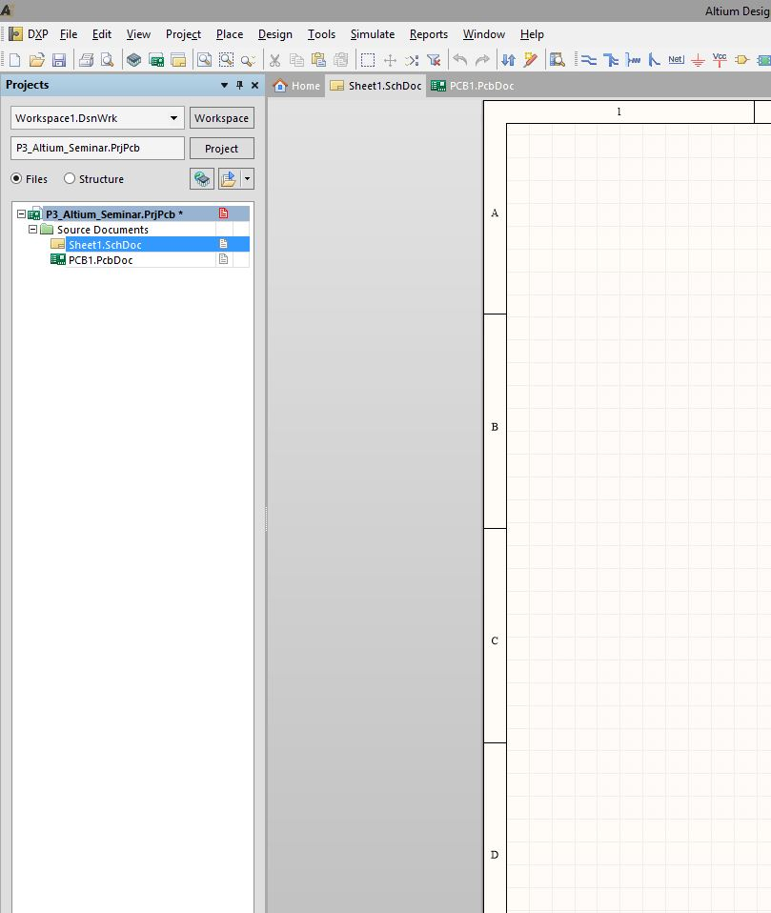
Project Window

Slide 13
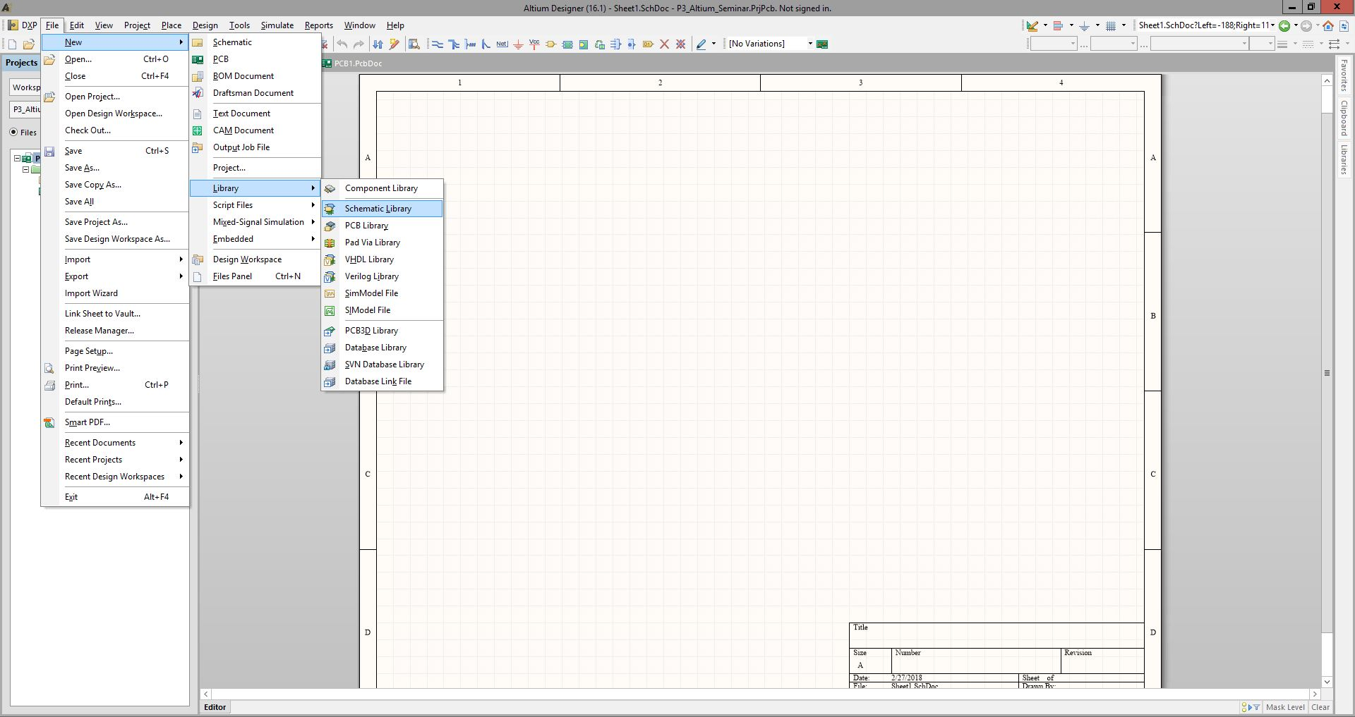
Add Schematic Library, PCB Library

Slide 14
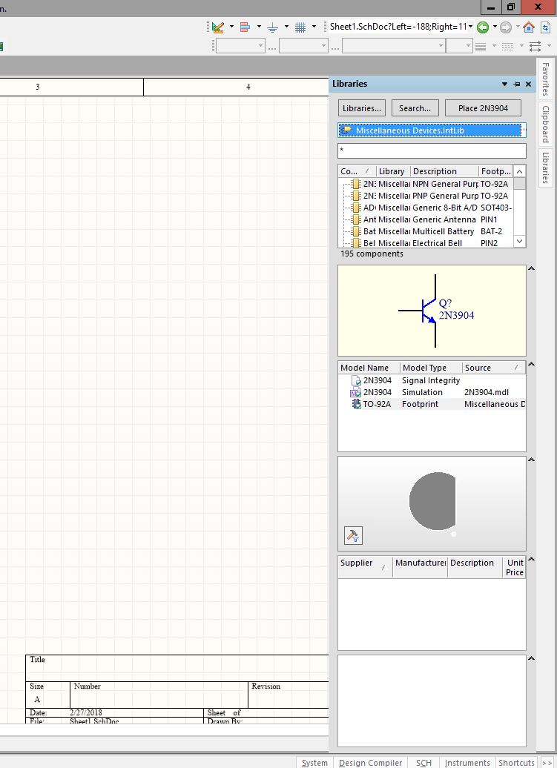
Back to Sheet1.SchDoc
Click Libraries on right side
Drag symbols onto the screen
Use the search tool, drag
Spacebar to rotate components

Slide 15
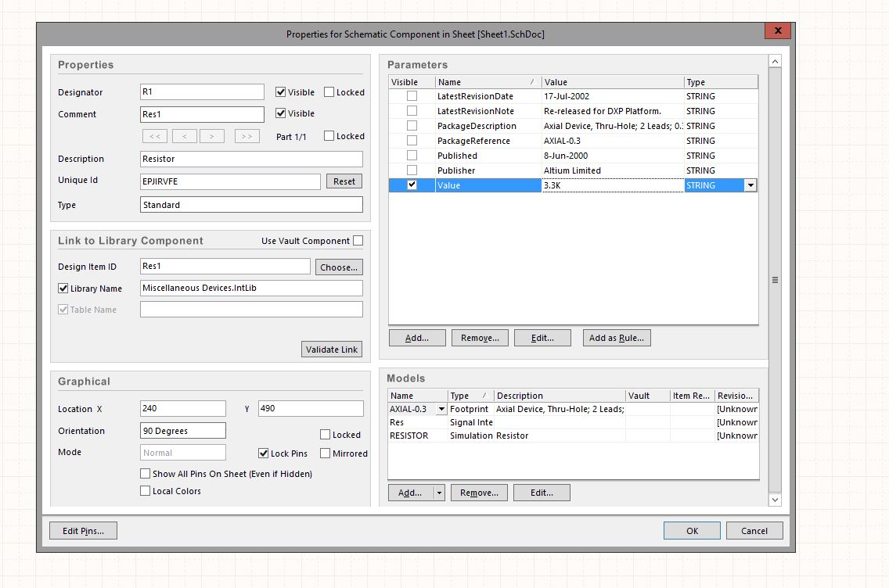
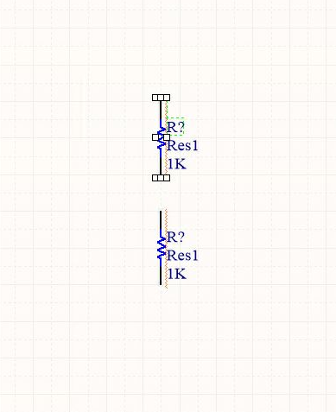
Add two resistors, change values

Slide 16
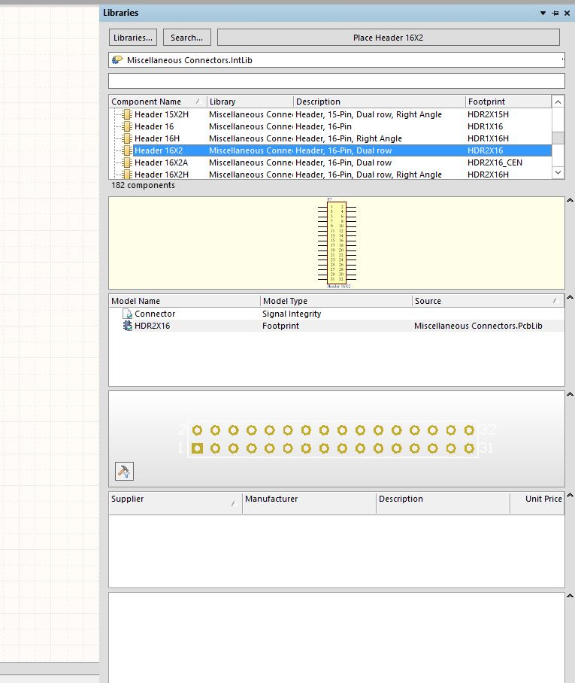
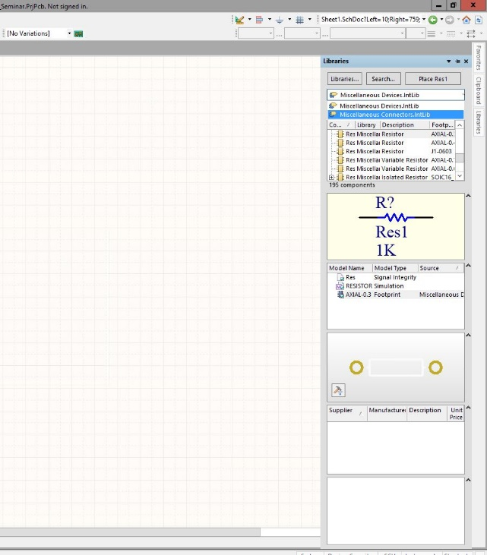
Add Header

Slide 17
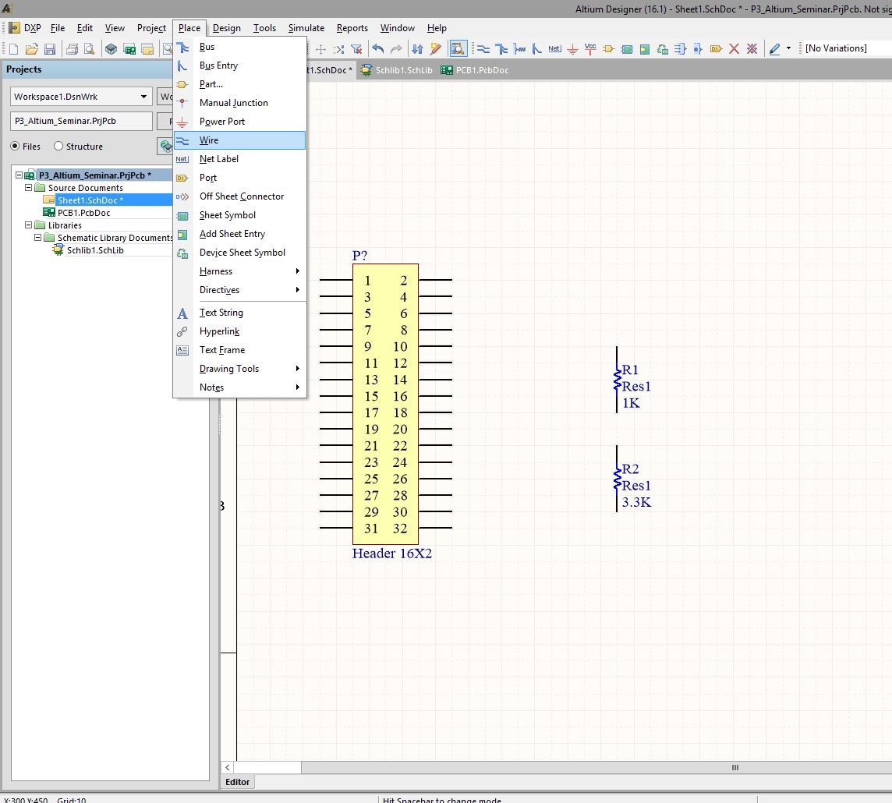
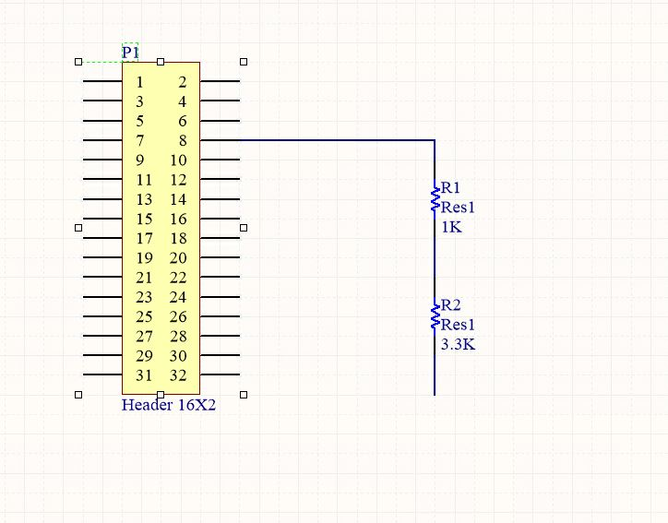
Add Wire

Slide 18
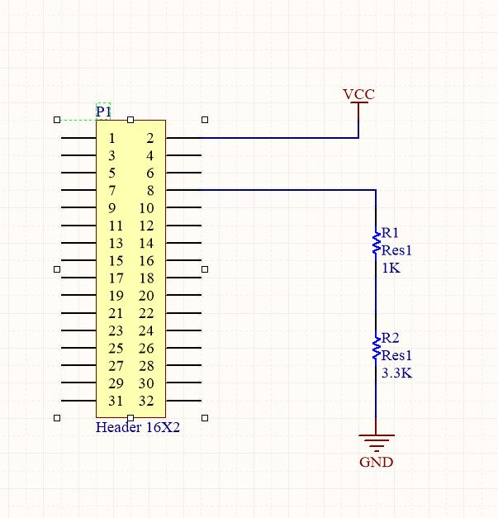
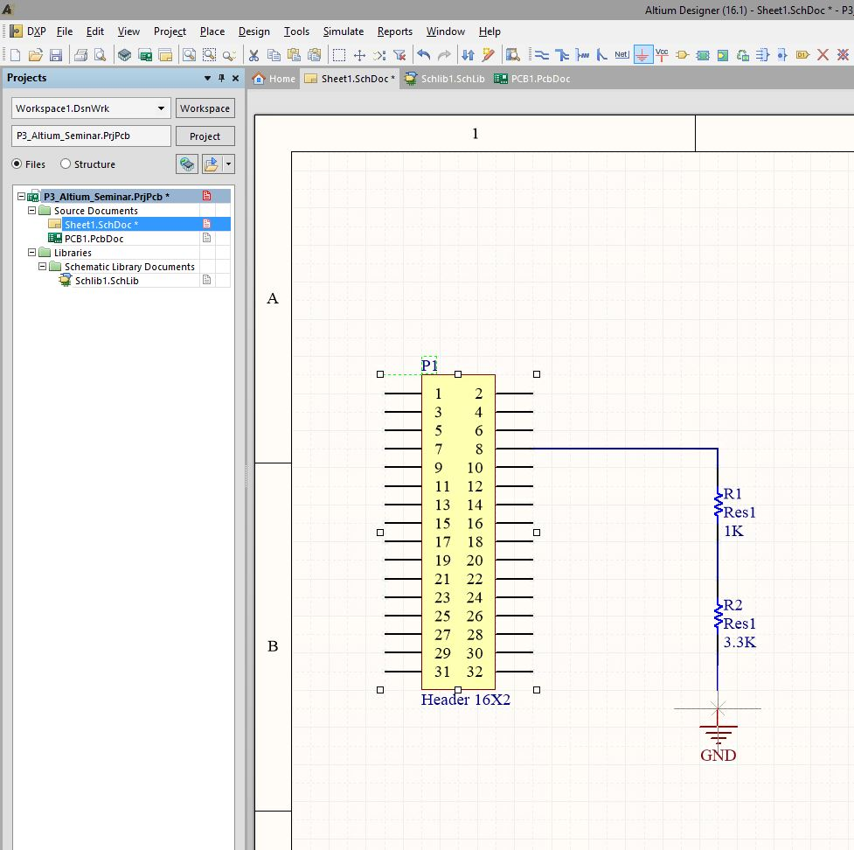
Add Power Ports

Slide 19
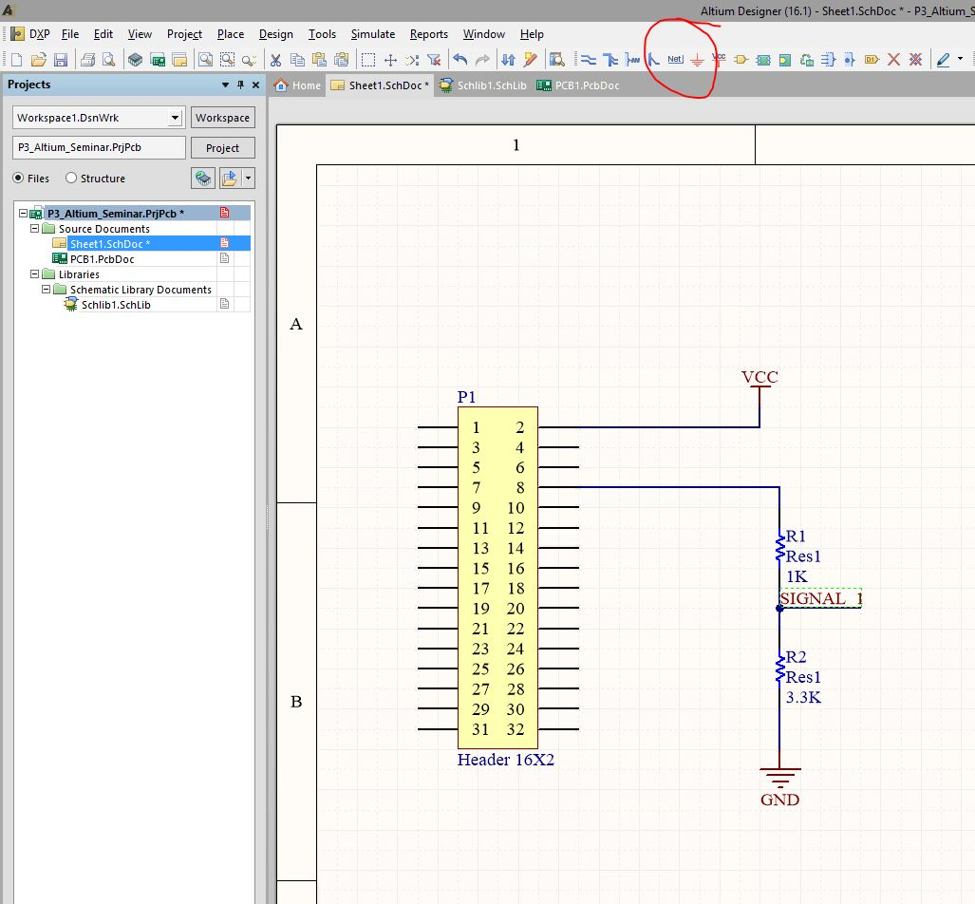
Add Net Name

Slide 20
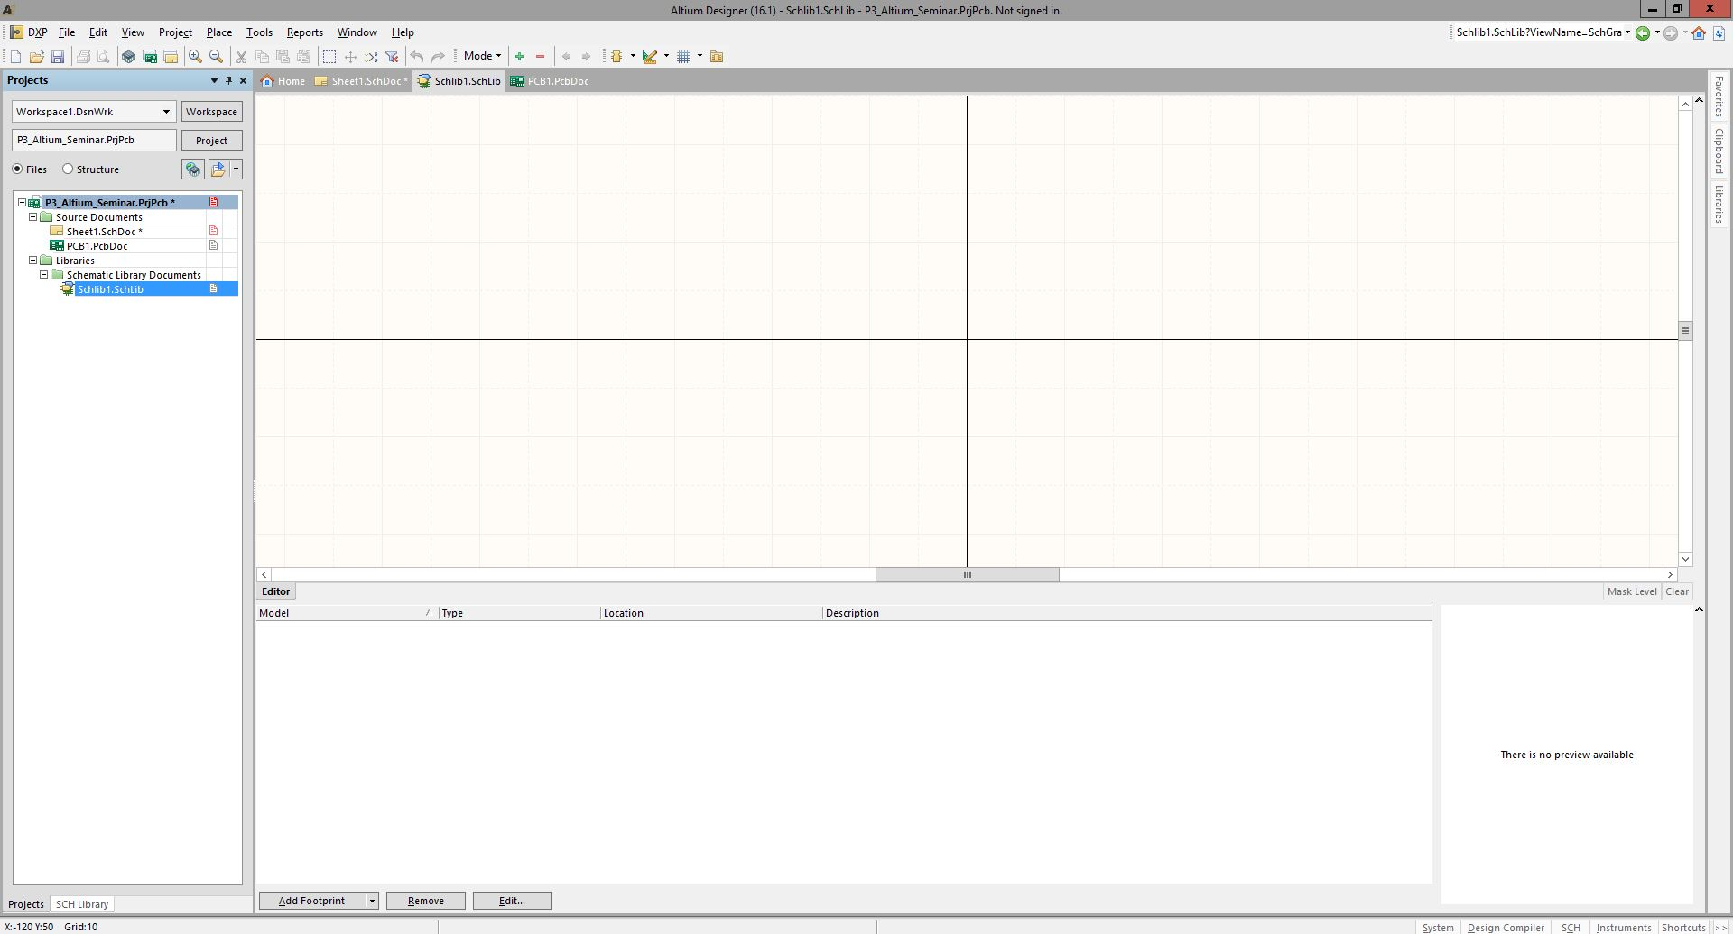
Open Schematic Library

Slide 21
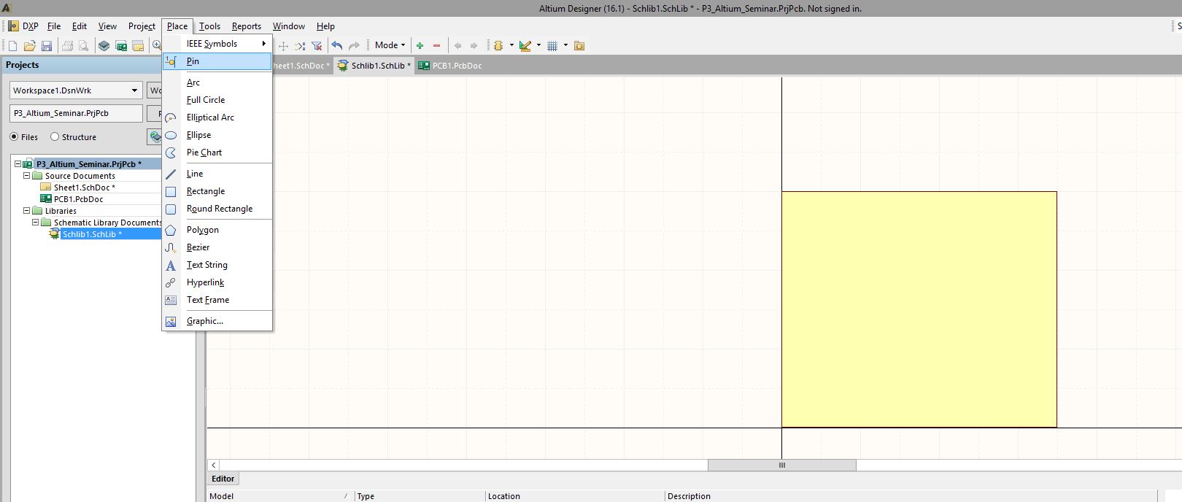
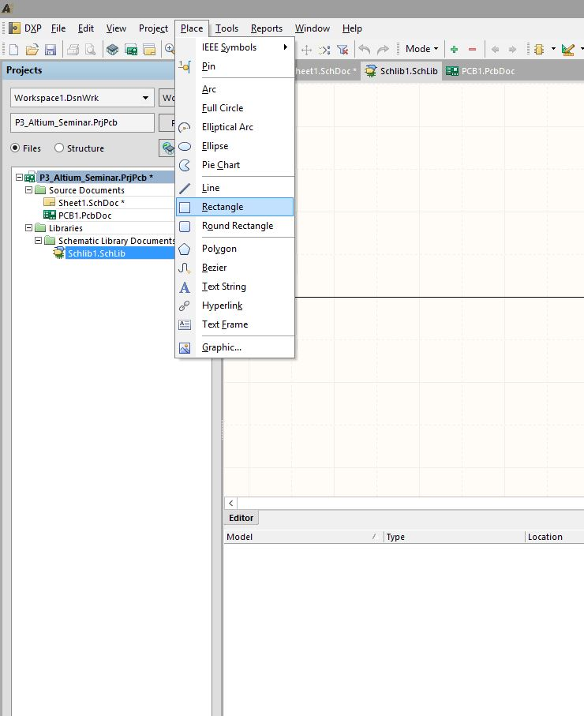
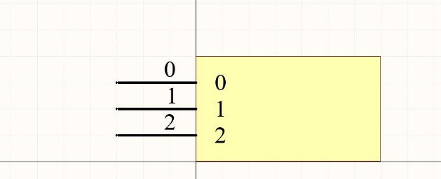
Add Primitives

Slide 22
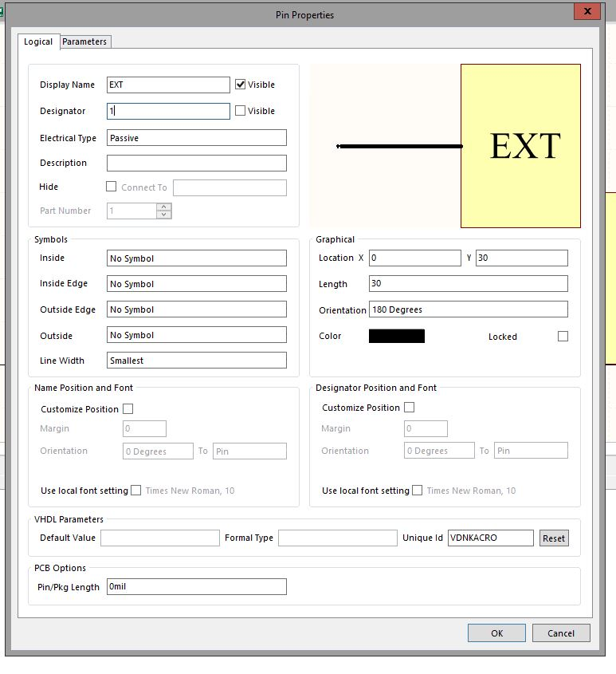
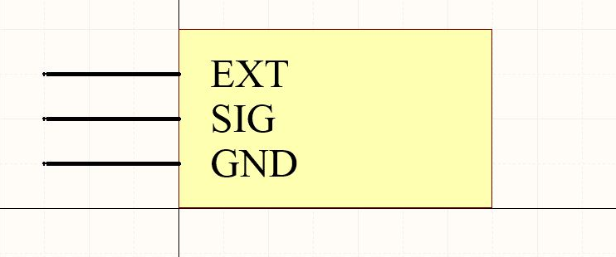
Add Labels
Designators should be 1, 2, 3 for this demo
Designators can be visible or invisible
Be sure to save the SchLib when complete

Slide 23
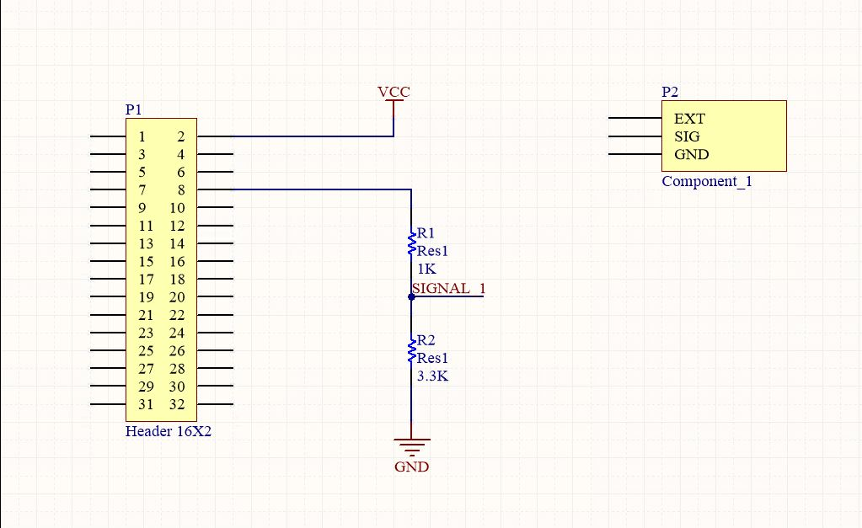
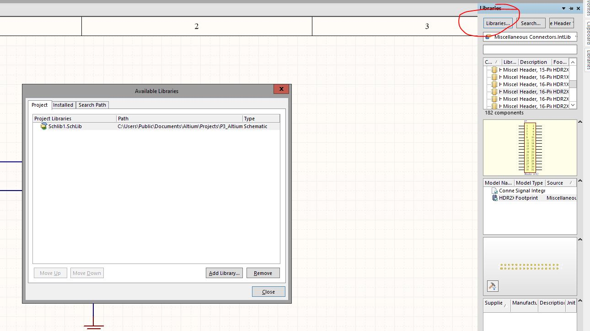
Back to SchDoc, Link Library, Drag Header

Slide 24
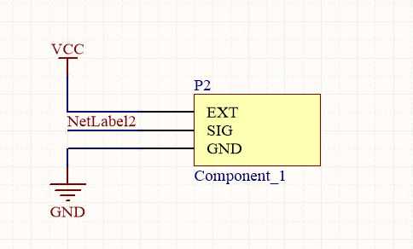
Add Header, Nets

Slide 25
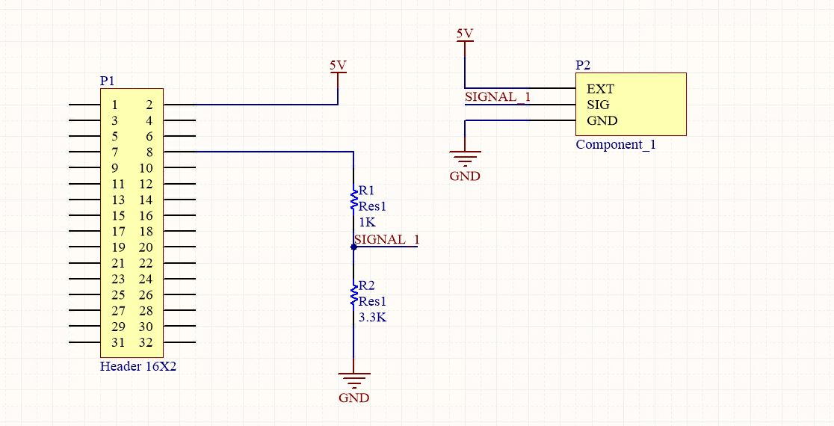
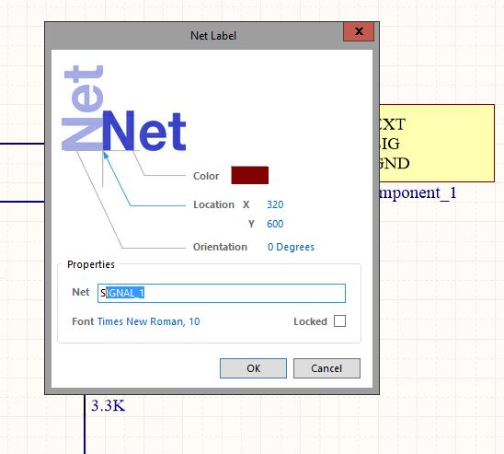
Rename Nets
Save when you are done!

Slide 26
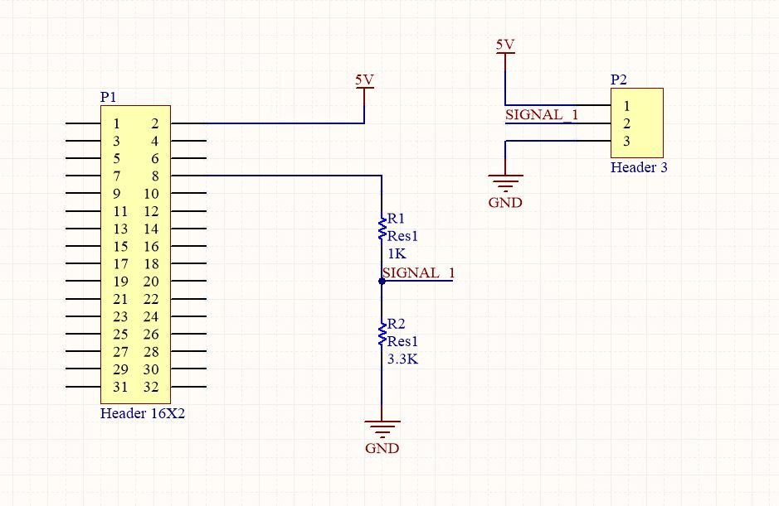
Change Header (Demo Only)
Linking components to footprints can take awhile, so for simplicity we’ll just replace our header with a standard 10” header

Slide 27
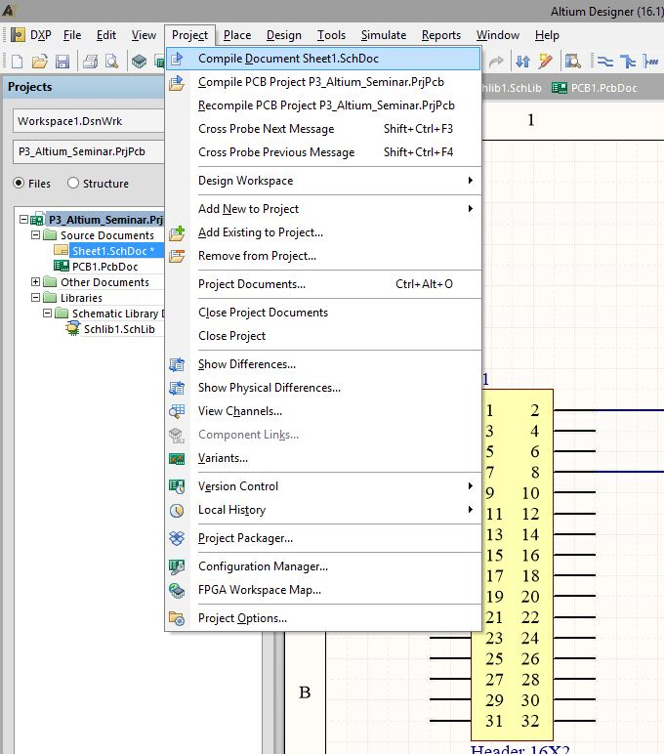
Compile
Quick Check that basic requirements are met
-- Warning/error box will only appear if warning or errors are present -- Does not mean your schematic is perfect, just that design rules are followed
After you complete, save SchDoc ats PCB1.SchDoc (or whatever name your PCB is called) and save whole project

Slide 28
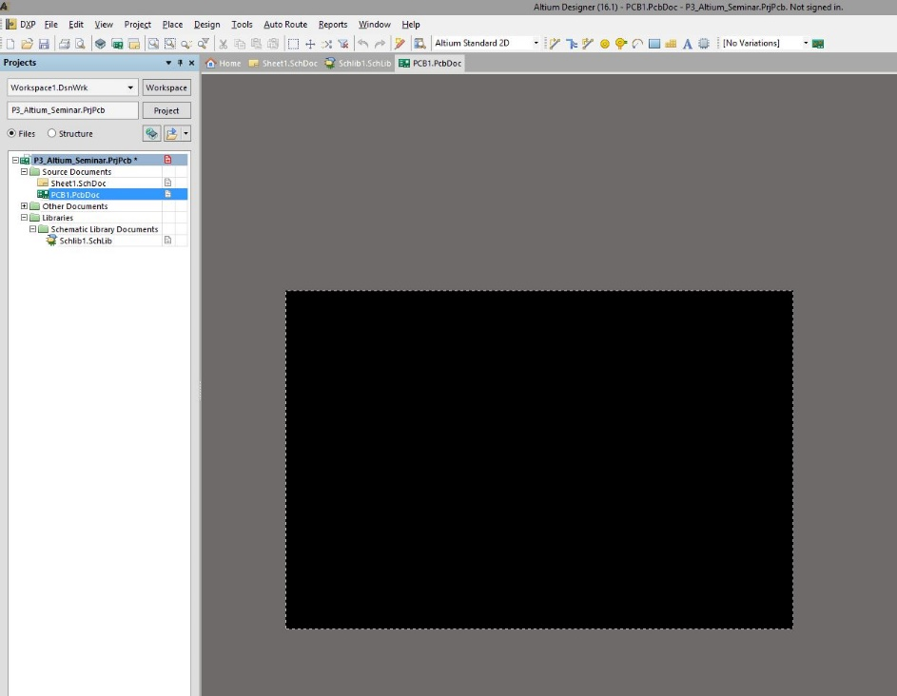
Click PCB1.PcbDoc
Layout Mode
Keys for moving around:
-- Up/Down: Scroll
--Left/Right: Shift Scroll
-- Zoom: CTRL Scroll
--Change Layer: Click layer on bottom

Slide 29
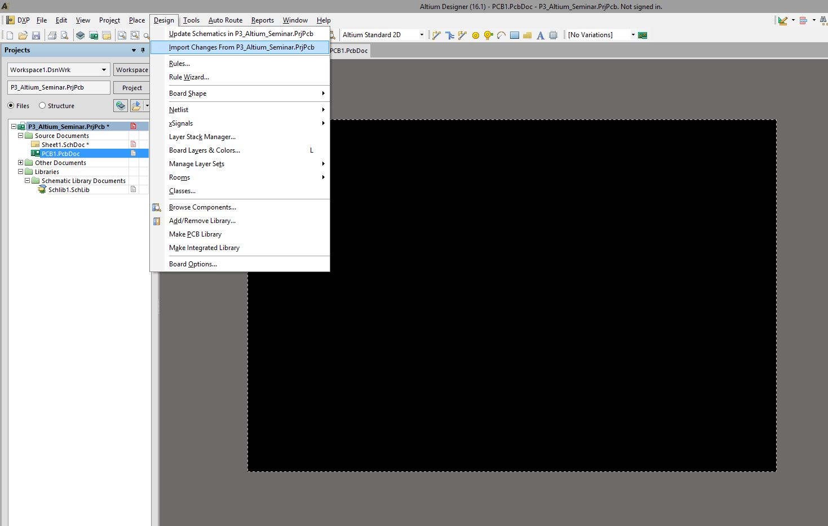
Import Changes
Create Engineering Change Order

Slide 30
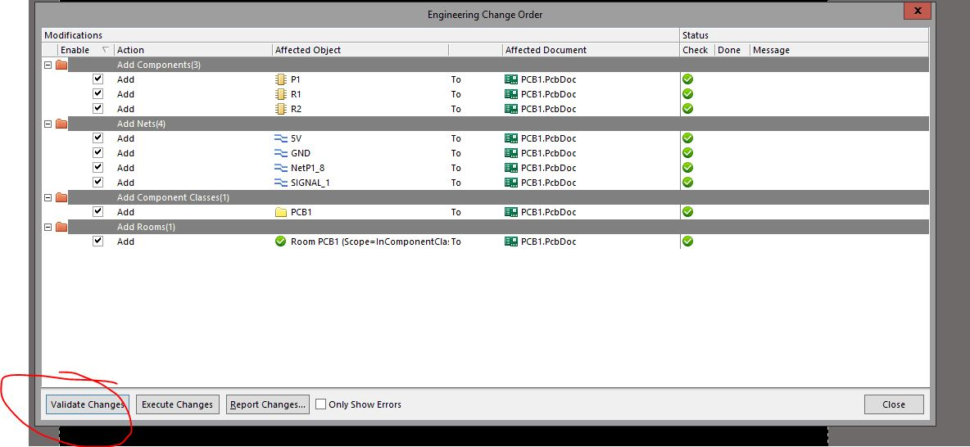
Validate and Execute Changes

Slide 31
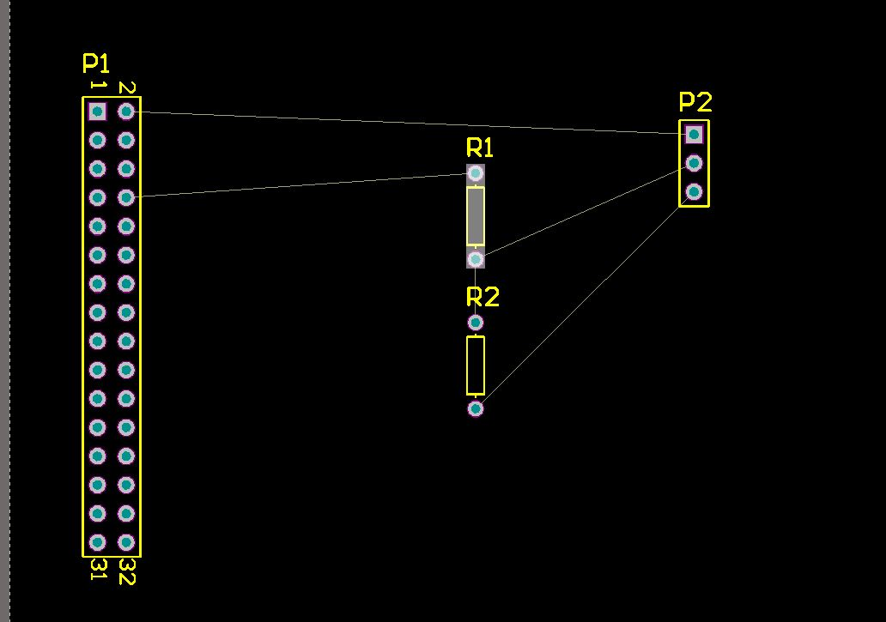
Position Components
While dragging, hit the spacebar to rotate
Delete red box
Yellow lines connect nets
Board space, size and component placement are very important, but not covered here
Your board should look something like this!

Slide 32
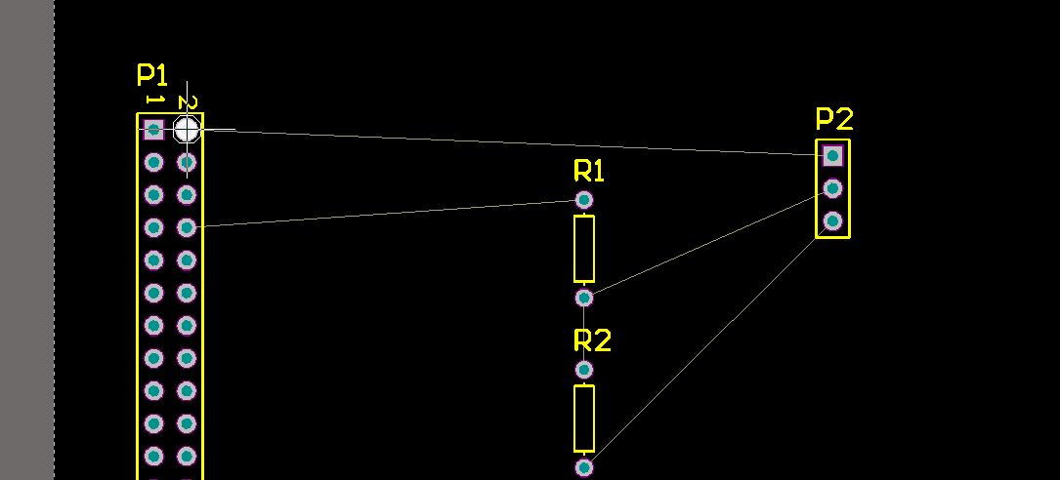
Routing
Place > Interactive Route to start routing
Make sure you’re on the top layer

Slide 33
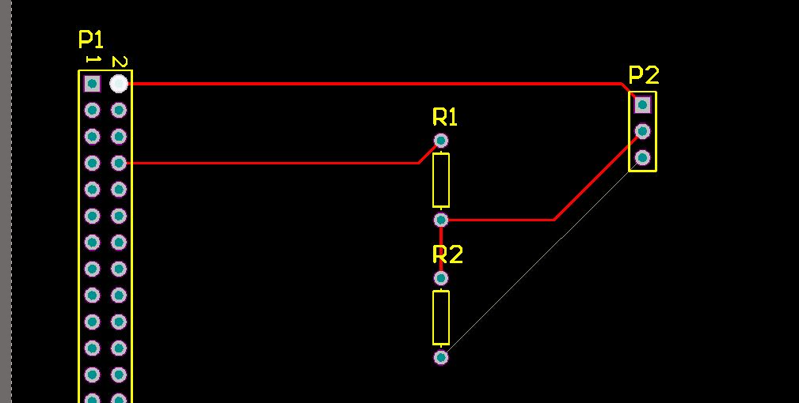
Start Routing
Route all nets besides GND
-Trace width is important
-Routing is important

Slide 34
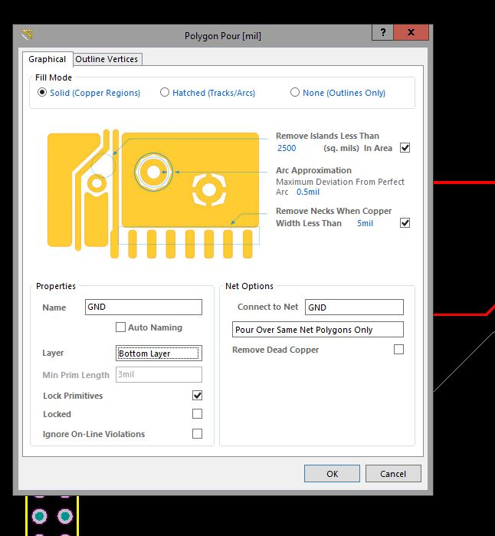
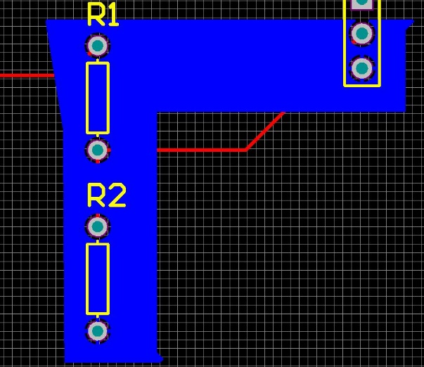
Polygon Pour
Geometric tool is difficult to use
Right click > Polygon Actions > Repour All if you need to make two polygons to
Notice how only the GND pins are connected
In a real board, you have to balance ground plane size with other requirements (i.e. don’t make a huge rectangle around your whole board)

Slide 35
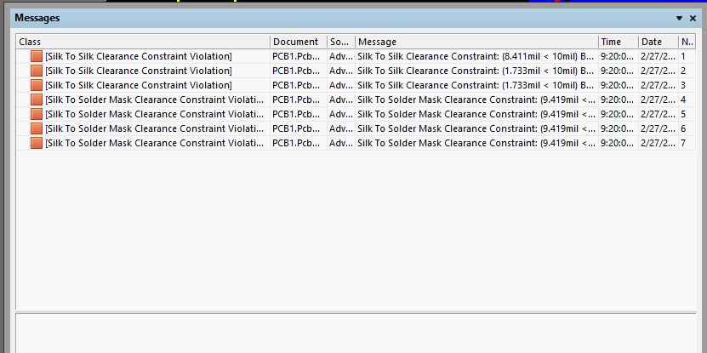
Completed Board!
Tools > Design Rule Check
Altium is a professional tool. You can change a rule if you want to make things pass but be careful!

Slide 36
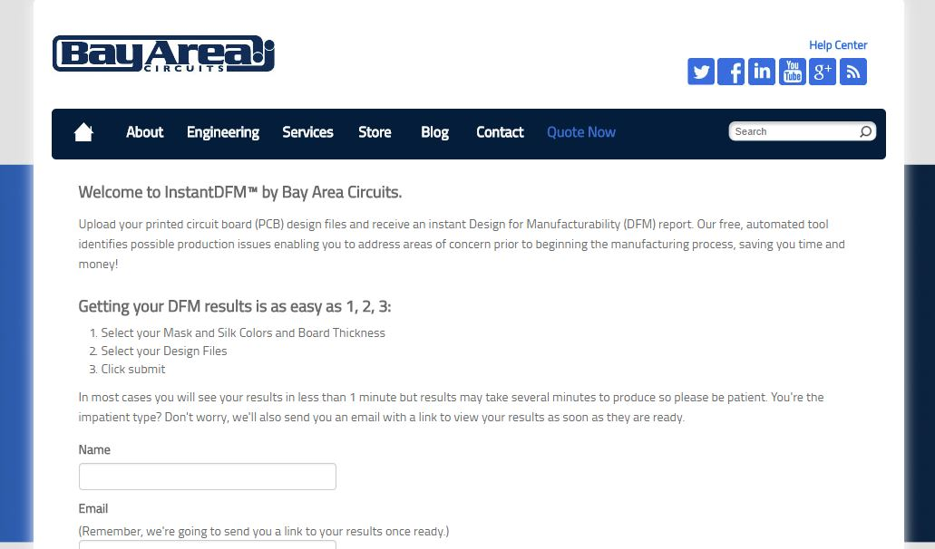
Gerber Outputs
File > Fabrication Outputs > Gerber
Set output parameters (check with your manufacturer)
Use an Instant DFM Checker like http://instantdfm.bayareacircuits.com/

Slide 37
Questions?

Slide 38
Join Badgerloop!
https://www.badgerloop.com/#/contact
Electrical Team Meetings Thursdays at 8pm in ME 1255
badgerloop.slack.com
Build a pod. Have fun. Learn a lot. (None of us knew how to do any of this 8 months ago)

